Slide 1
NHAO NIC Flat
2020-07-28 Yoonsoo P. Bach
All the codes and FITS files (except for the very raw data) are available via my personal Dropbox:
https://www.dropbox.com/sh/s3g5e4dv3m84flx/AACLHo2sRoScz6Fxg3lvbId4a?dl=0

Slide 2
Combining Dome Flats
Scale each raw frame by its mean value
multiplied scale is scale[i] = median(image[i])/median(image[0])
CCDCLIP algorithm with 3-sigma clip, median center, nkeep=5.
Gain, readout noise form header
The sigma-map is calculated by stddev(survived-values) at each pixel position.
SNR = combined pixel value / sigma-map
Normalized flat = combined image / mean(combined image)

Slide 3
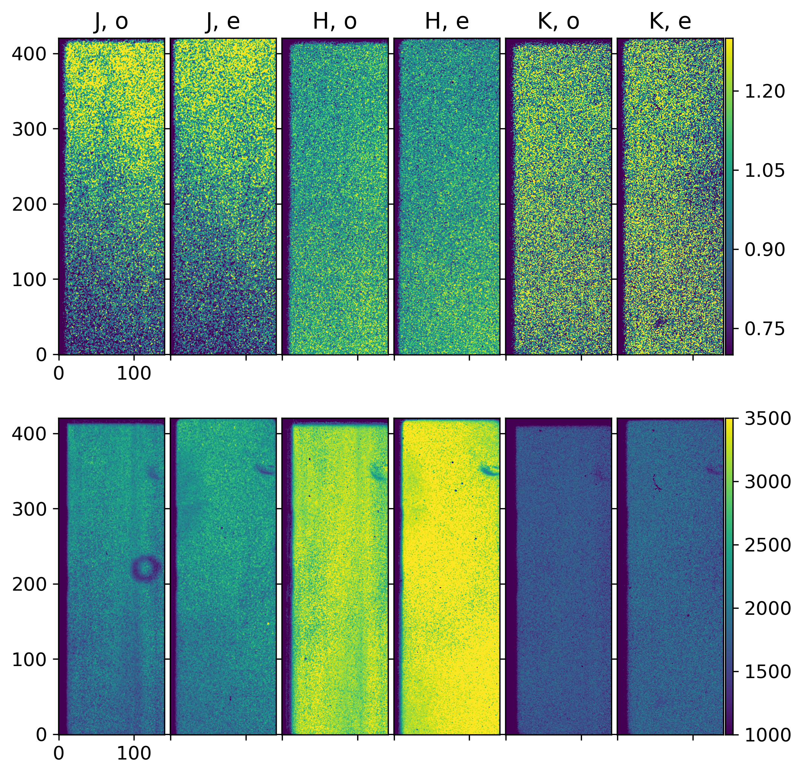
Simple results
Simple combining of all flats
Dust-donuts that were invisible in the flat are visible in the SNR map.
Normalized flat
SNR

Slide 4
Components of Flats
Header keywords: FILTER, POL-AGL1, INSROT
Plus: o/e-ray
Notation:
<FILTER>_<POL-AGL1:04.1f>_<INSROT:+04.0f>_<oe:s>.fits
j_00.0_+045_e.fits
= J-filter, HWP 0.0˚, INSROT 45˚, e-ray part.

Slide 5
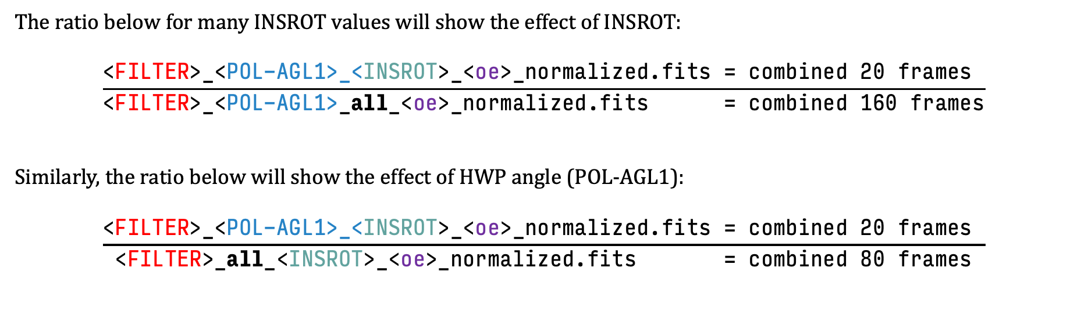
Effects of INSROT/POLAGL
The ratio below for many INSROT values will show the effect of INSROT:
$$\frac{\text{<}\text{FILTER}\text{>_<}\text{POL}\text{−}\text{AGL}\text{1>_<}\text{INSROT}\text{>_<}\text{oe}\text{>}\text{_}\text{normalized}\text{.}\text{fits}\text{ =} \text{combined} \text{20 }\text{frames} }{\text{<}\text{FILTER}\text{>_<}\text{POL}\text{−}\text{AGL}\text{1>_}\text{all}\text{_<}\text{oe}\text{>}\text{_}\text{normalized}\text{.}\text{fi}\text{ts}\text{ = }\text{combined} \text{160 }\text{frames}}$$
Similarly, the ratio below will show the effect of HWP angle (POL-AGL1):
$$\frac{\text{<}\text{FILTER}\text{>_<}\text{POL}\text{−}\text{AGL}\text{1>_<}\text{INSROT}\text{>_<}\text{oe}\text{>}\text{_}\text{normalized}\text{.}\text{fits}\text{ = }\text{combined}\text{ 20 }\text{frames} }{\text{<}\text{FILTER}\text{>_}\text{all}\text{_<}\text{INSROT}\text{>_<}\text{oe}\text{>}\text{_}\text{normalized}\text{.}\text{fi}\text{ts}\text{ = }\text{combined}\text{ 80 }\text{frames}}$$

Slide 6
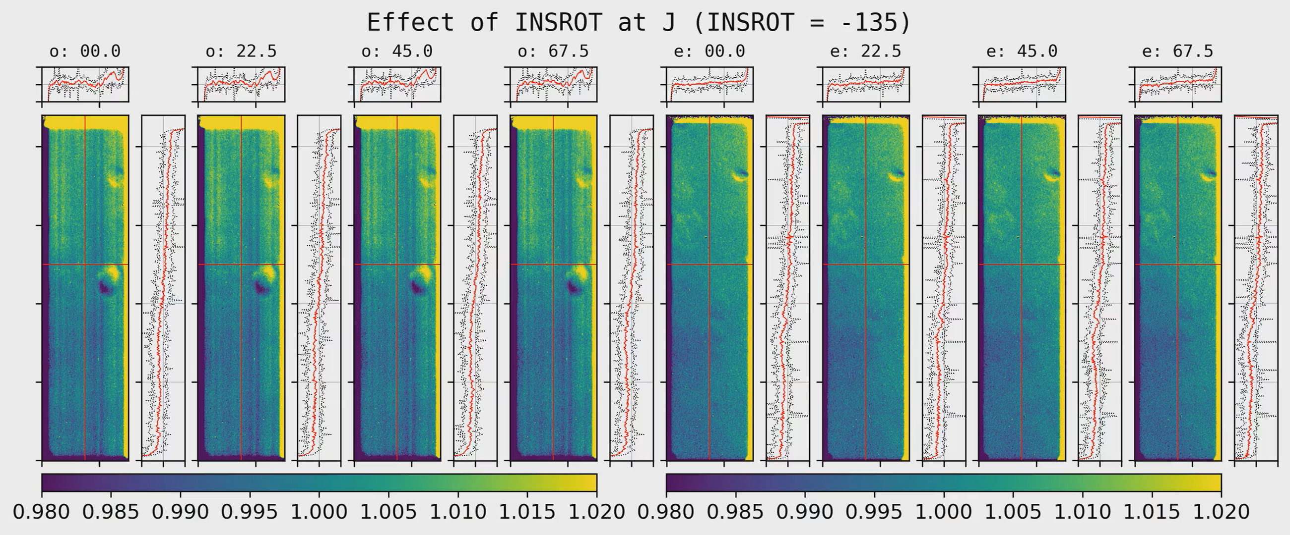
1. Effect of INSROT
Cut profile at red lines ± 10 pix width are shown.
This is where we usually put our target.
Black dotted lines = min/max at that ± 10 pixel region.
ticks for cut-profiles: 1 ± 0.02 (2%)
ticks for image axis: 100 pix
<oe>: <POL-AGL1>

Slide 7
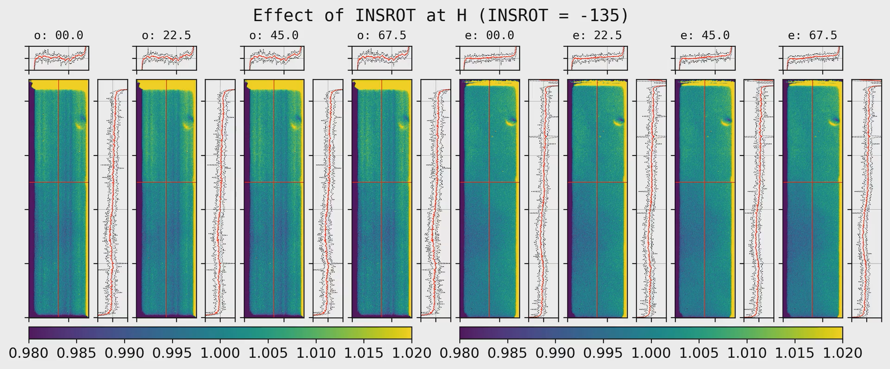
1. Effect of INSROT
Cut profile at red lines ± 10 pix width are shown.
This is where we usually put our target.
Black dotted lines = min/max at that ± 10 pixel region.
ticks for cut-profiles: 1 ± 0.02 (2%)
ticks for image axis: 100 pix
<oe>: <POL-AGL1>

Slide 8
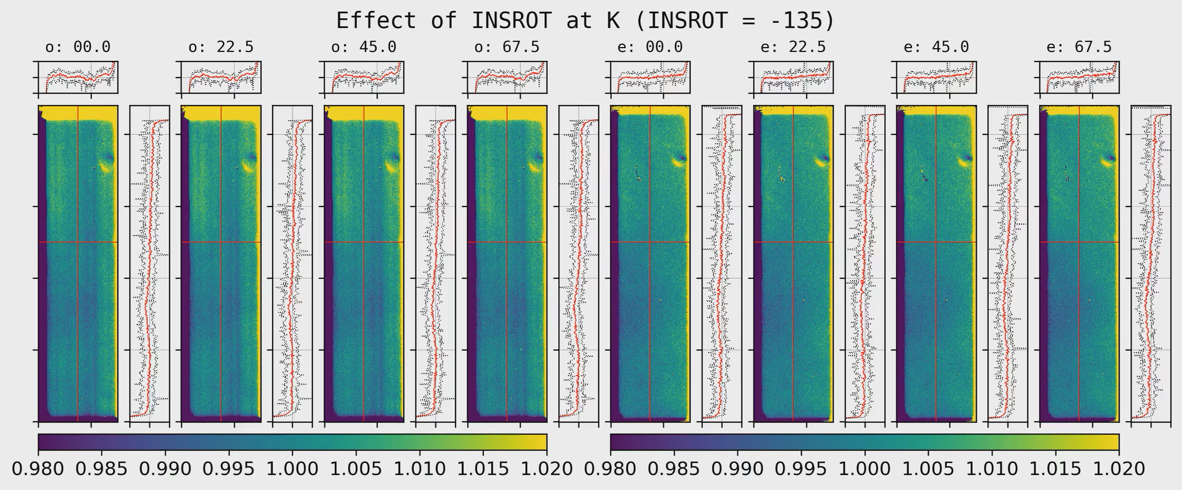
1. Effect of INSROT
Cut profile at red lines ± 10 pix width are shown.
This is where we usually put our target.
Black dotted lines = min/max at that ± 10 pixel region.
ticks for cut-profiles: 1 ± 0.02 (2%)
ticks for image axis: 100 pix
<oe>: <POL-AGL1>

Slide 9
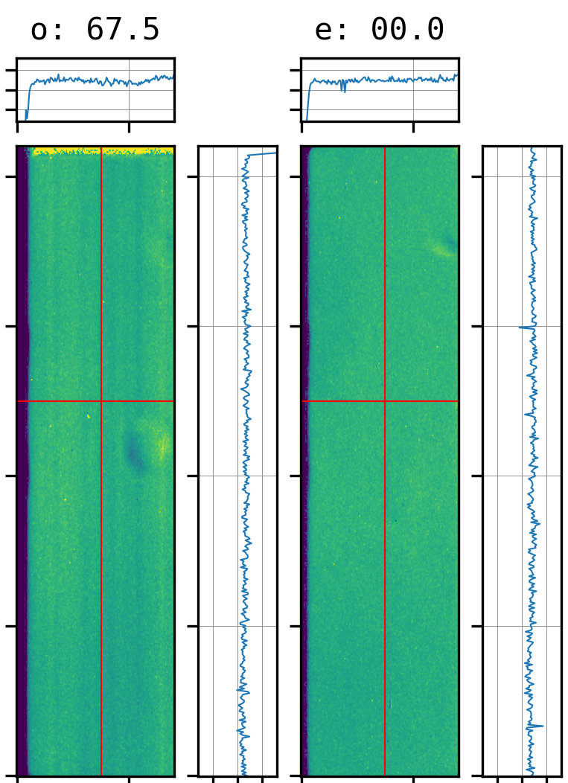
Notes
The peak-trough locations of dust donuts rotate as INSROT angle.
The dust indicated by orange arrow is visible only in J, while others appear in all o/e rays in all filters.
Maybe a hint for where the dusts are located.

Slide 10
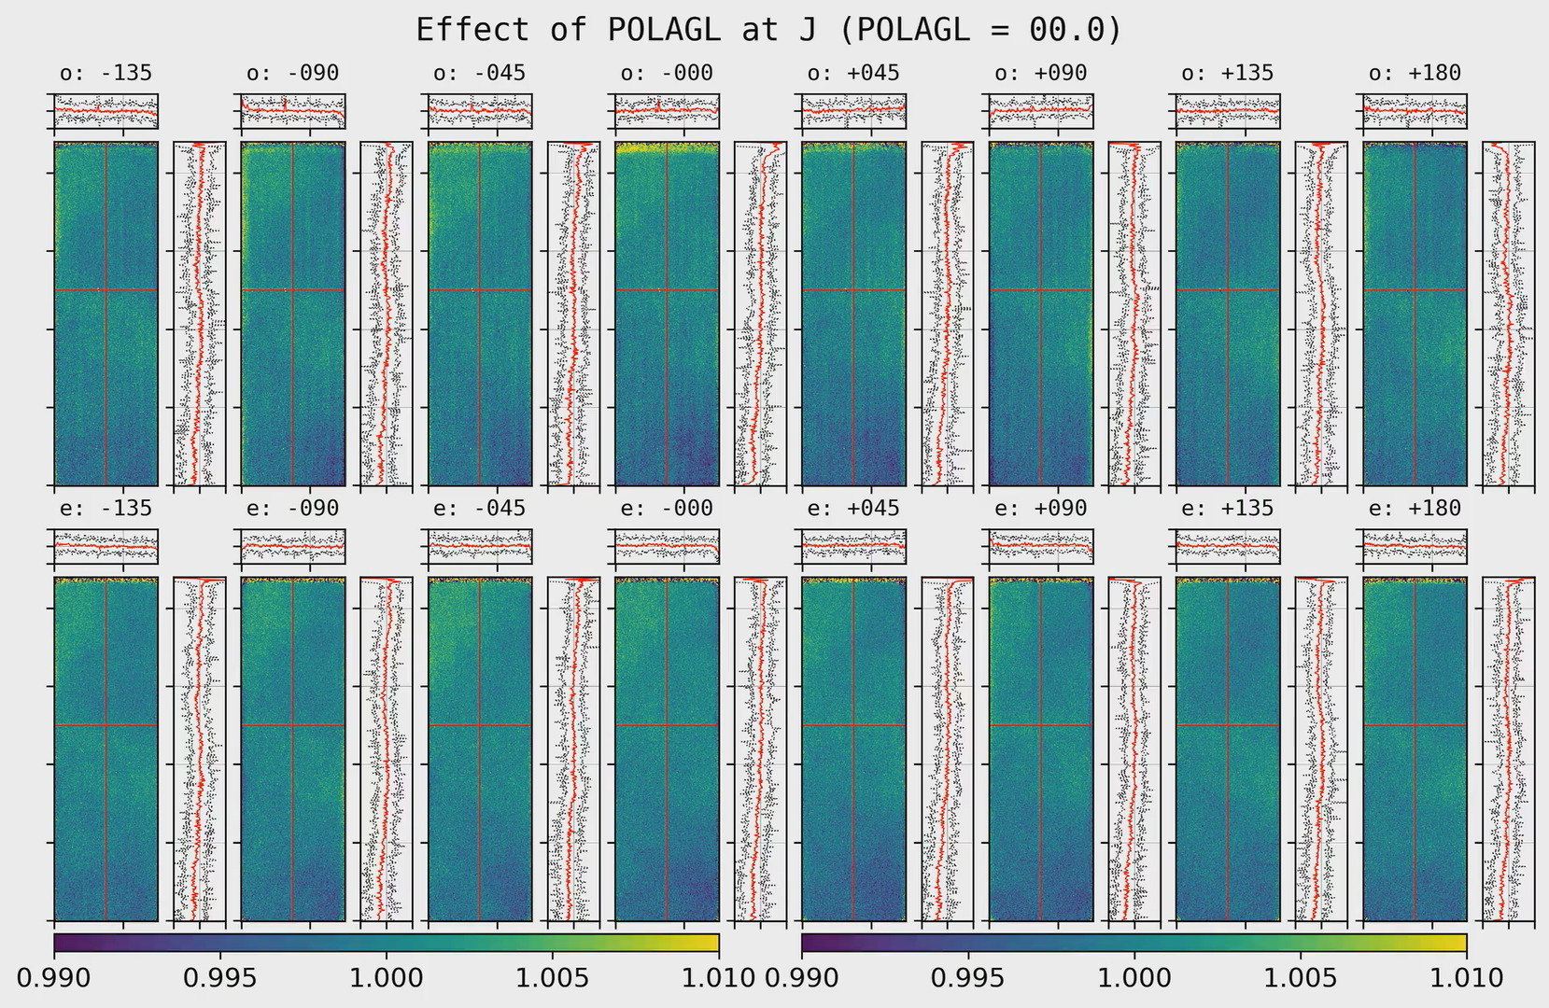
2. Effect of POL-AGL1 (HWP angle)
ticks for cut-profiles: 1 ± 0.01 (1%)
ticks for image axis: 100 pix
Cut profile at red lines ± 10 pix width are shown.
This is where we usually put our target.
Black dotted lines = min/max at that ± 10 pixel region.

Slide 11
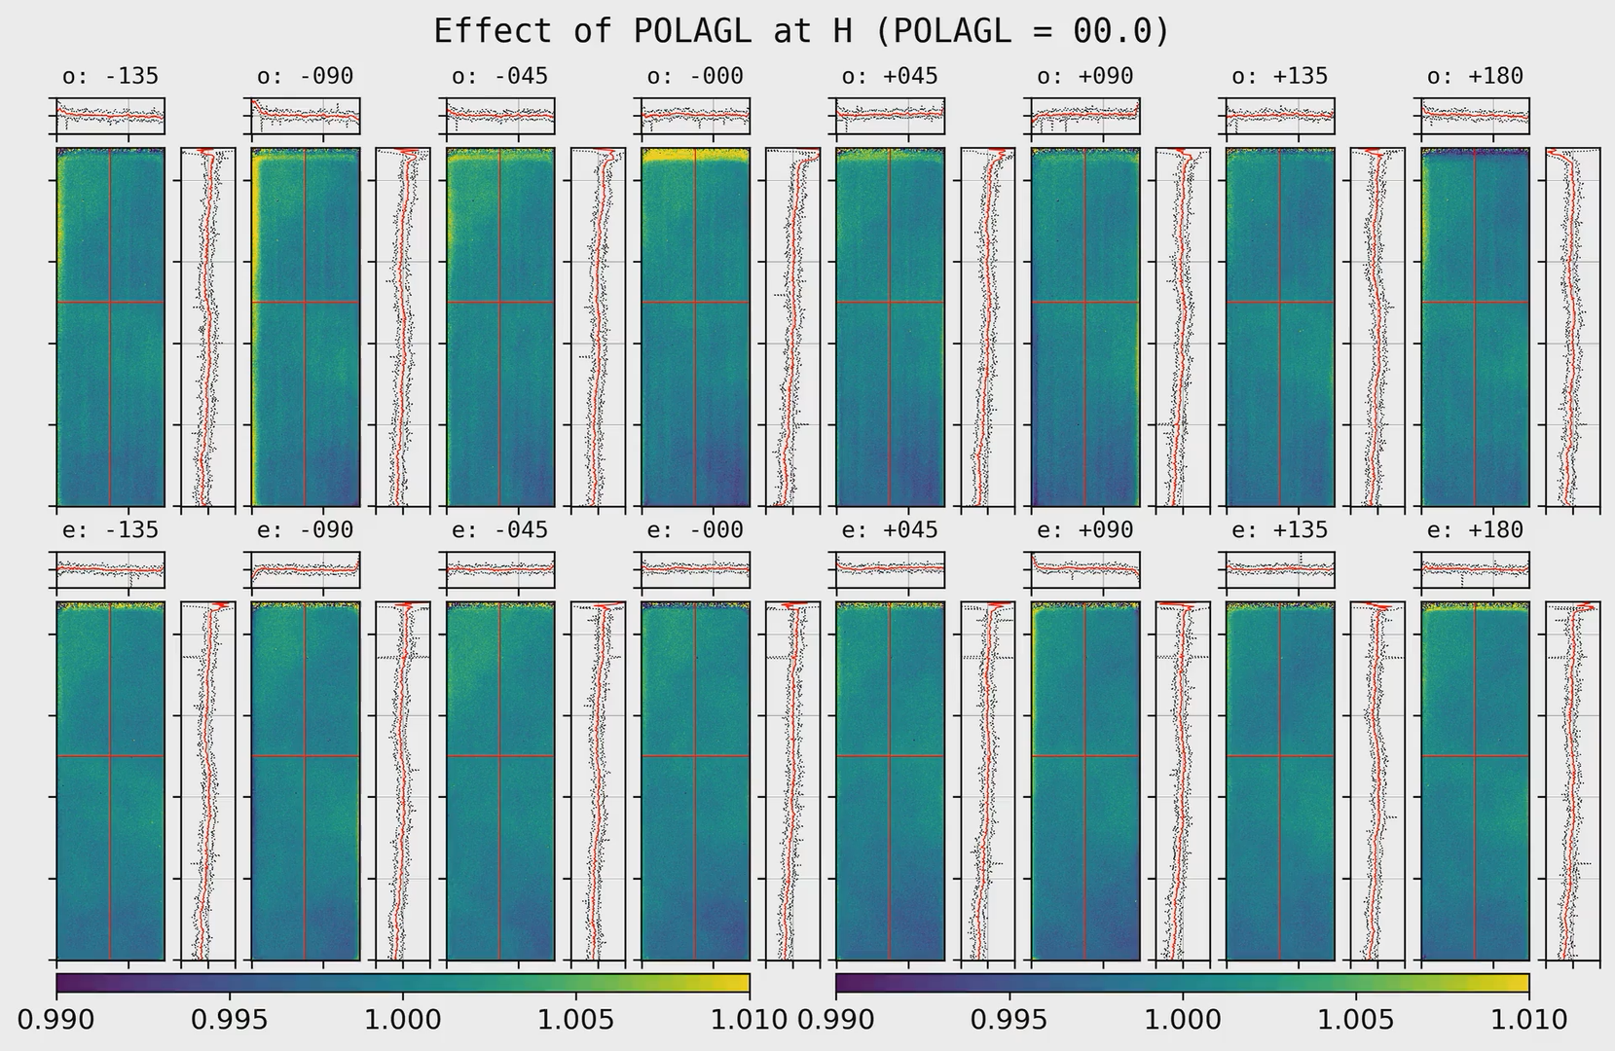
2. Effect of POL-AGL1 (HWP angle)
ticks for cut-profiles: 1 ± 0.01 (1%)
ticks for image axis: 100 pix
Cut profile at red lines ± 10 pix width are shown.
This is where we usually put our target.
Black dotted lines = min/max at that ± 10 pixel region.

Slide 12
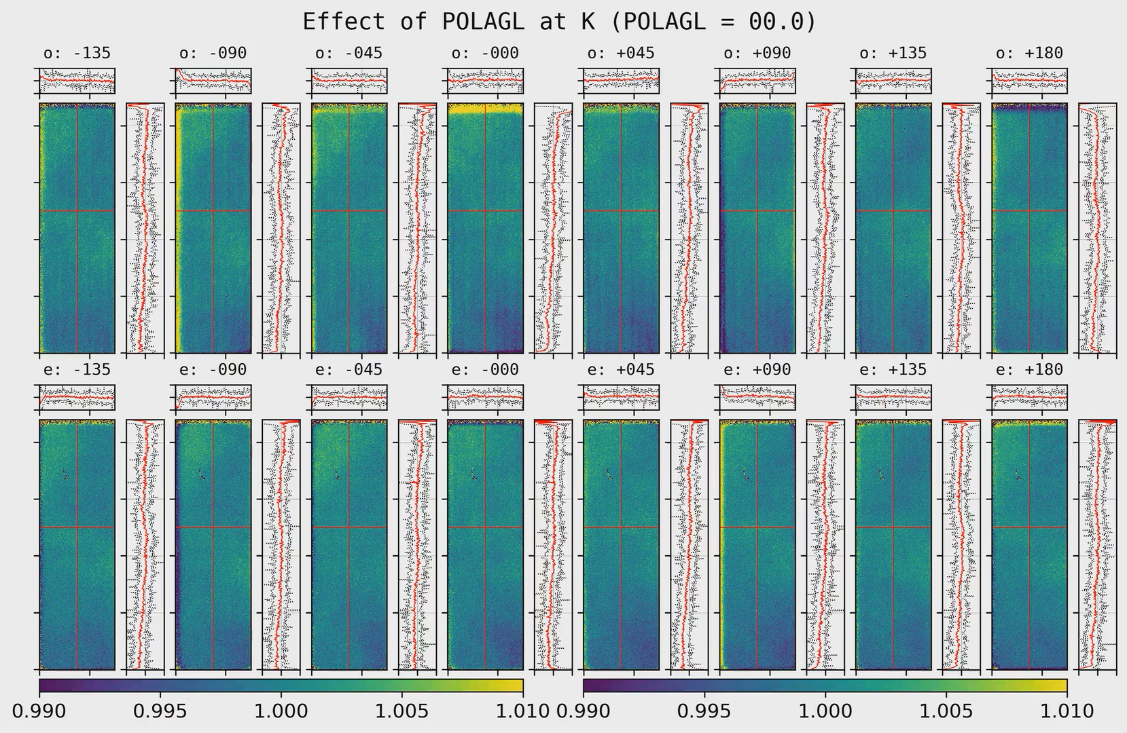
2. Effect of POL-AGL1 (HWP angle)
ticks for cut-profiles: 1 ± 0.01 (1%)
ticks for image axis: 100 pix
Cut profile at red lines ± 10 pix width are shown.
This is where we usually put our target.
Black dotted lines = min/max at that ± 10 pixel region.

Slide 13
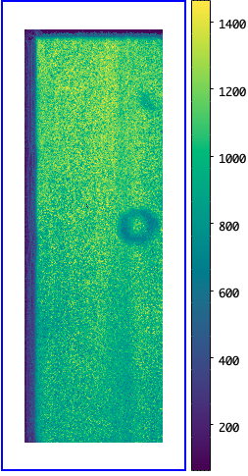
Notes
Why there's no dust donut?
The dust-donuts' shapes are dependent on INSROT, but not on POL-AGL1.
Hence, a flat with fixed POL-AGL1 (combined over all INSROT) will have no dust donut feature.
The dust donut, however, will appear in the SNR map.
Dust = lower ADU = lower SNR (simply considering photon noise)
As INSROT changes, dust donut's brightness distribution changes → higher stddev → lower SNR
(SNR := combined value at a pixel / stddev of that pixel)

